Slide 1
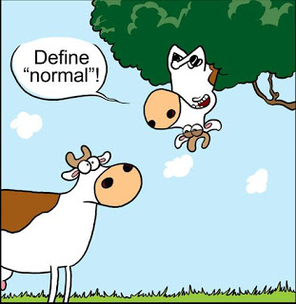
Cancer UNIT 2
What does it mean to be a ‘normal’ cell?

Slide 2
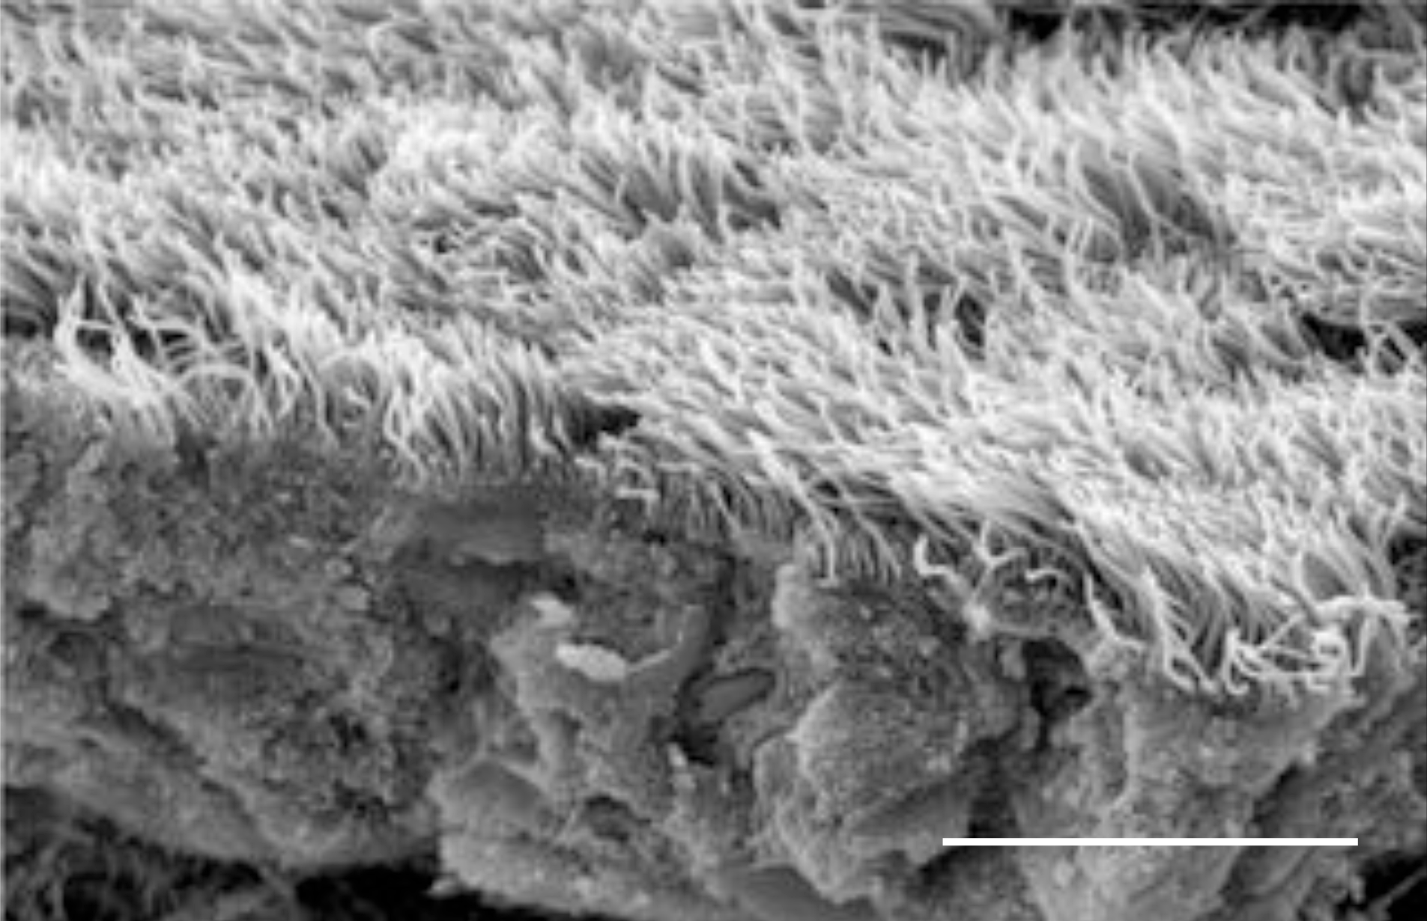
Cancer
Lesson 2.1
What type of normal cell is most vulnerable to becoming a cancer cell, and why?
10 microns
Epithelial cells in the lung with cilia that brush away debris

Slide 3
Do Now
Match the following systems with their organs:
Circulatory
Reproductive
Digestive
Immune
Skeletal
Nervous
Integumental
Endocrine
Excretory
Respiratory
Muscular
Bone
Brain
Breast
Heart
Kidney
Lung
Lymphatics
Muscle
Ovary/Testis
Skin
Stomach

Slide 4
Organs perform specific functions
Heart: Circulate blood | Lung: Absorb oxygen | Testis/Ovaries: Make gametes
Skeletal Muscle: Move body parts | Breast: Make milk for offspring | Lymph nodes: Make immune cells
Brain: Controls bodily functions and behavior | Stomach: Digest food | Skin: Cover organs and protect body
Bone: Provide structure to body | Kidney: Purify blood and secrete waste

Slide 5
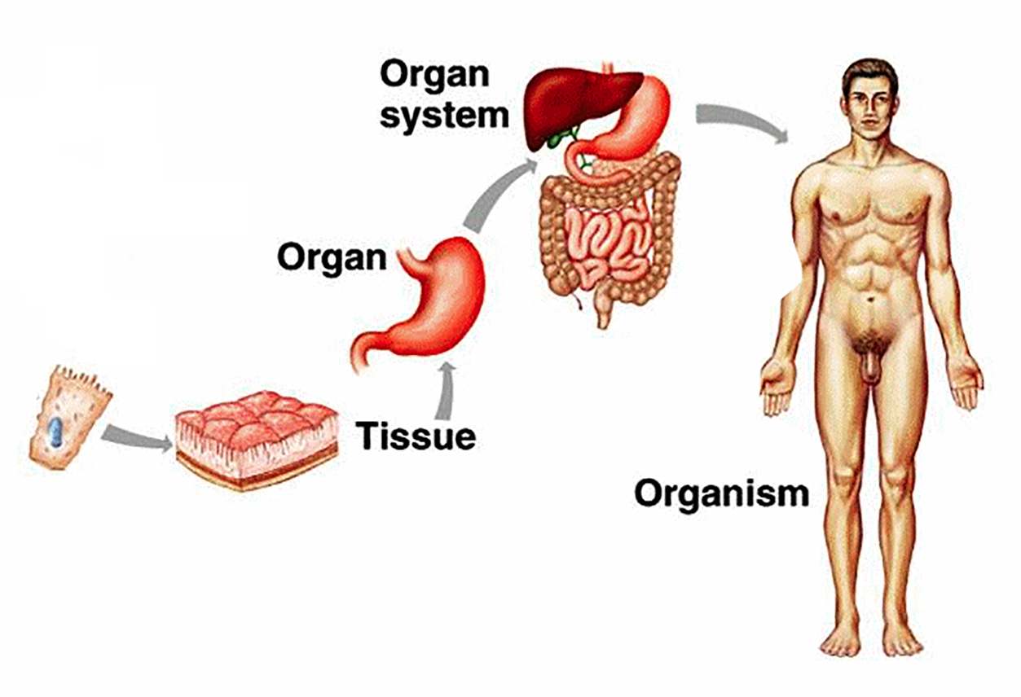
Organs are made of tissues

Slide 6
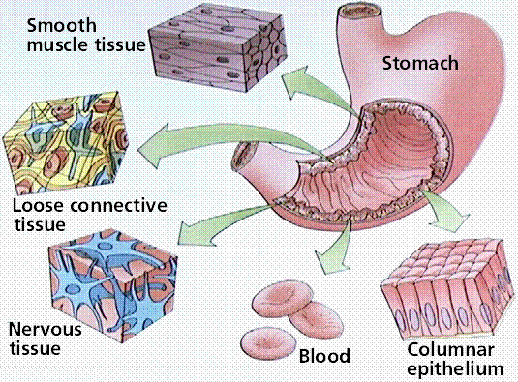
Tissues perform specific functions

Slide 7
Tissues perform specific functions
We call the tissue that performs the organ’s function parenchyma.
We call the tissue that supports the organ’s function stroma.

Slide 8
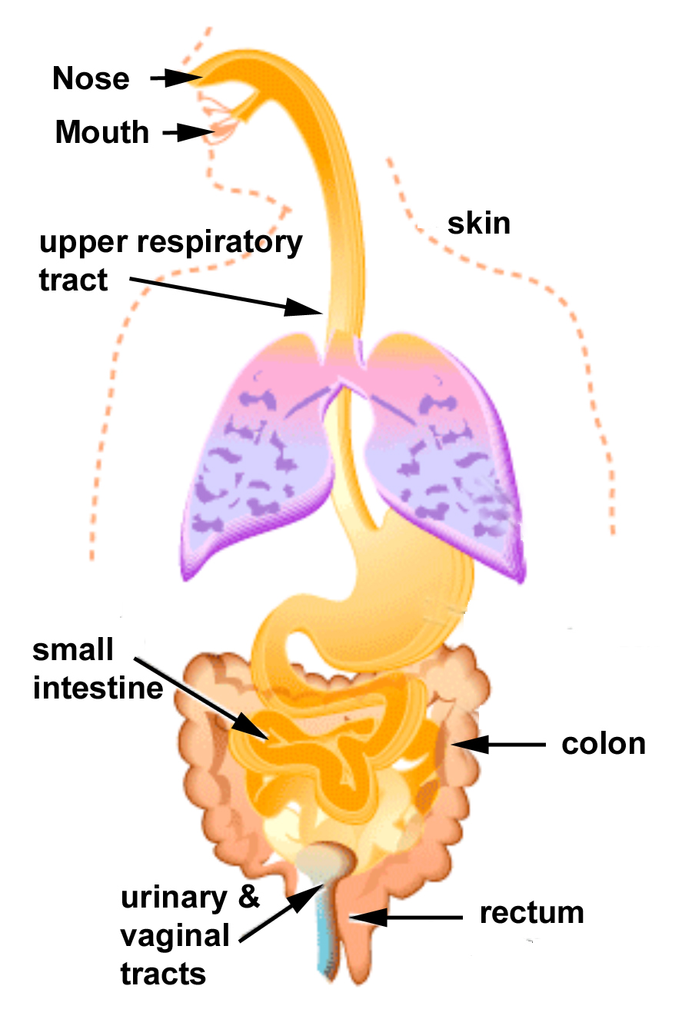
Tissues often form tubes

Slide 9
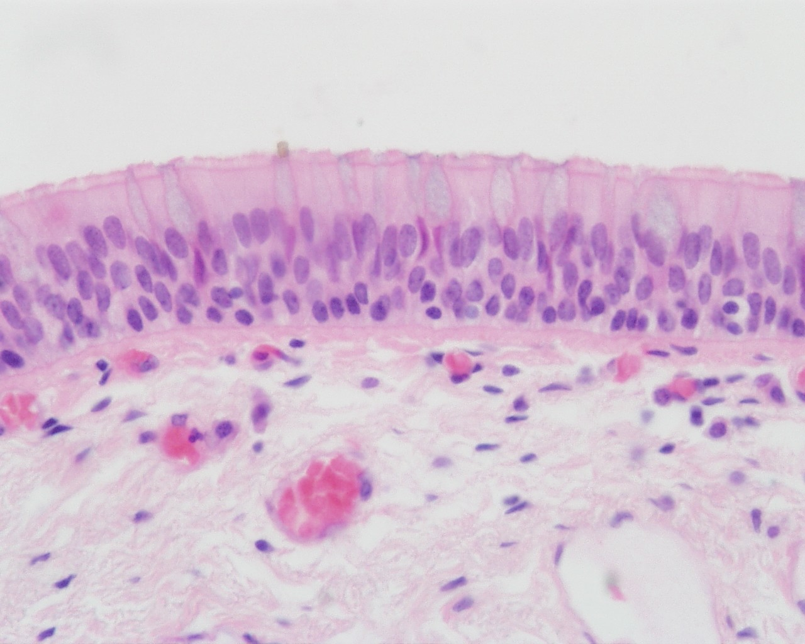
Tissues often form tubes The esophagus

Slide 10
The Esophagus’s Parenchyma Tissue
Parenchyma
Esophagus

Slide 11
The Esophagus’s Stroma Tissue
Parenchyma
Connective
tissue
Blood
vessel
Stroma
Esophagus

Slide 12
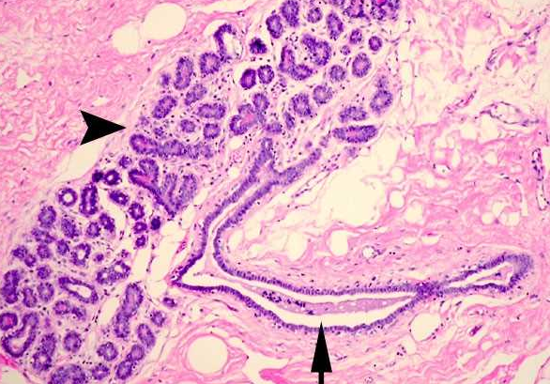
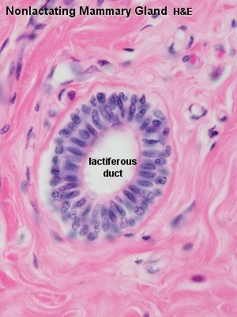
Our Organs’ Tissues often form Tubes Another example: The Breast
Parenchyma
Stroma

Slide 13
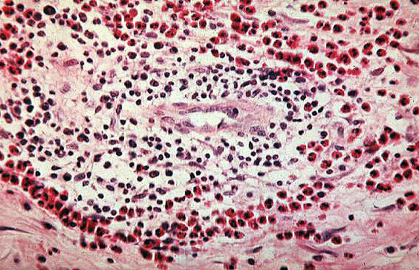
Tissues are made of a community of cells
Each member of the community serves a specific function
They work with other members to achieve bigger goals.

Slide 14
Parenchyma cells are often epithelia
Heart: Muscle Blood vessels Nerves Connective tissue | Lung: Epithelial cells Blood vessels Connective tissue | Testis: Epithelial cells Blood vessels Nerves Connective tissue
Skeletal Muscle: Muscle Blood vessels Nerves Connective tissue | Breast: Epithelial cells Blood vessels Nerves Connective tissue | Lymph nodes: Epithelial cells Blood vessels Connective tissue
Brain: Nerves Blood vessels Connective tissue | Stomach: Epithelial cells Blood vessels Nerves Connective tissue | Skin: Epithelial cells Blood vessels Nerves Connective tissue
Bone: Connective tissue Blood vessels | Kidney: Epithelial cells Blood vessels Nerves Connective tissue
In many organs, the parenchyma is composed of epithelial cells.

Slide 15
For example: The Esophagus’s Parenchyma
Lumen
Epithelial
cells
Parenchyma
Basement membrane
Stroma
Esophagus

Slide 16
There are four major types of Epithelial Cells
A. Squamous
B. Cuboidal
C. Columnar
D. Transitional

Slide 17
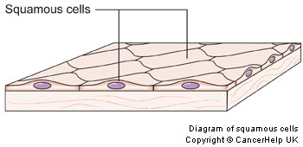
A. Squamous epithelial cells
Basement membrane
Function:
Cover and protect the body, organs & tissues
Found in:
Skin
Lining of throat, esophagus, lungs

Slide 18
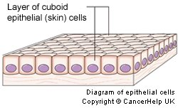
B. Cuboidal epithelial cells
Basement membrane
Function:
Secrete substances
Found in:
Breast (milk, hormones)
Ovaries (hormones)

Slide 19
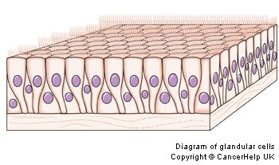
C. Columnar epithelial cells
Basement membrane
Function:
Absorb substances
Found in:
Intestines
Stomach

Slide 20
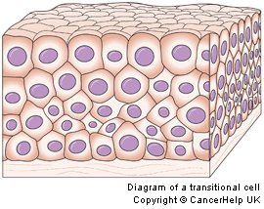
D. Transitional epithelial cells
Basement membrane
Function:
Allow for stretching in organs that can move
Found in:
Bladder
Genital tracts

Slide 21
Let’s revisit the Esophagus
Which of these cell layers is most exposed to carcinogens?
Lumen
Epithelial
cells
Parenchyma
Basement membrane
Connective
tissue
Blood
vessel
Stroma
Esophagus

Slide 22
Let’s revisit the Esophagus
The epithelial cells are the most exposed to the outside world and carcinogens.
Lumen
Epithelial
cells
Parenchyma
Basement membrane
Connective
tissue
Blood
vessel
Stroma
Esophagus

Slide 23
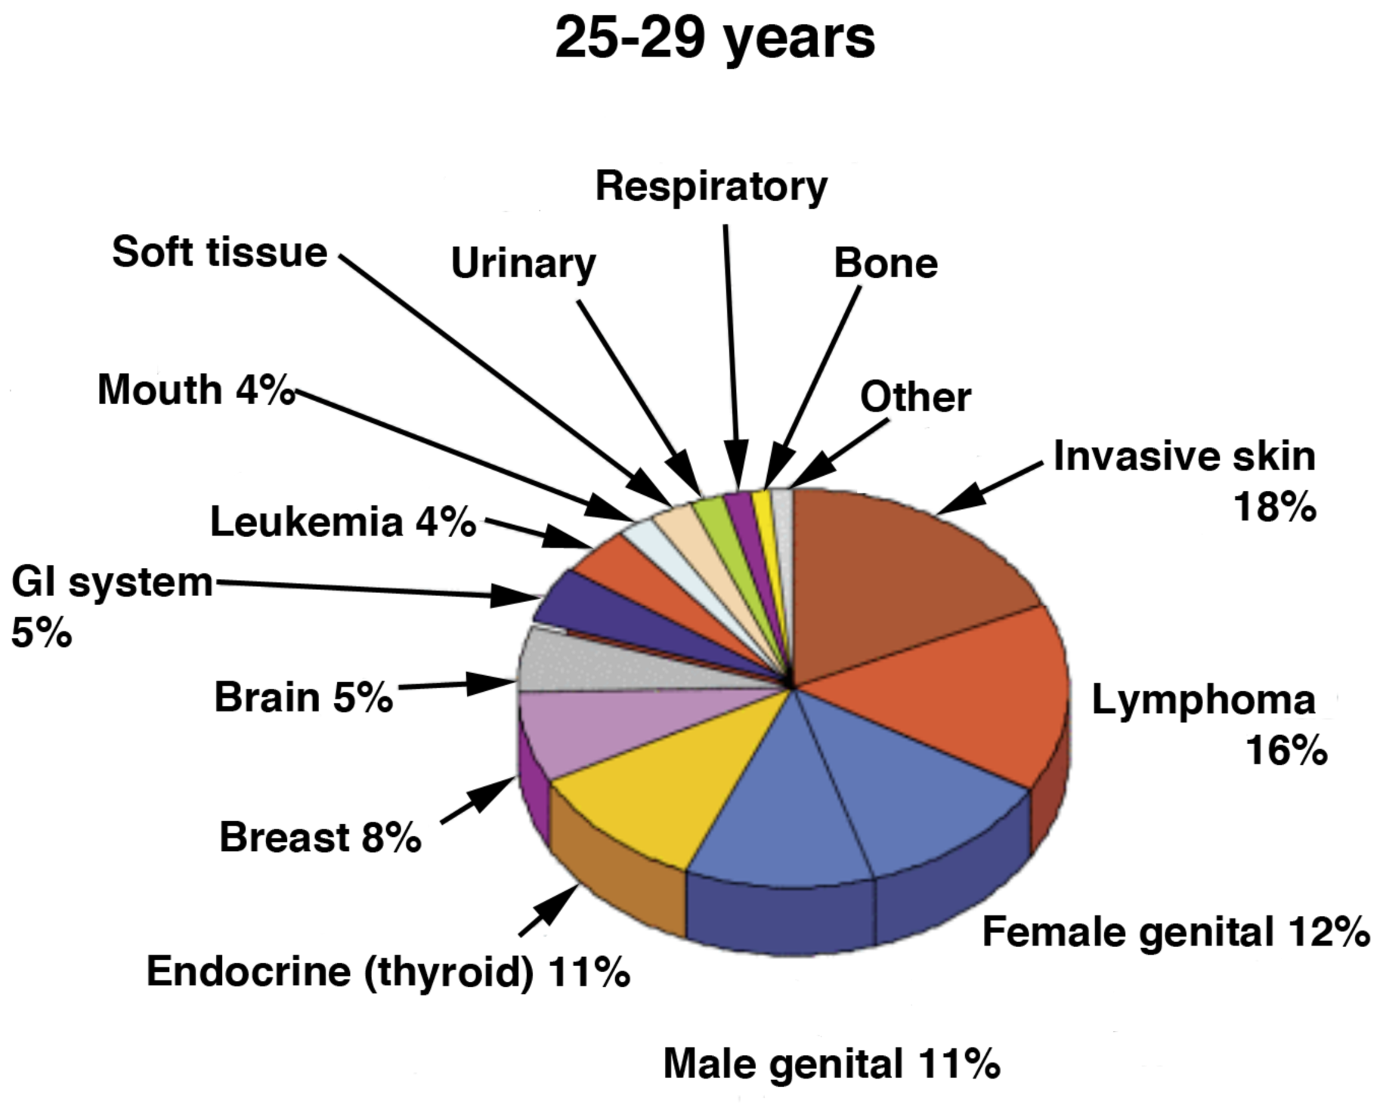
85% of all Cancers involve Epithelial Cells

Slide 24
Cancers of epithelial cells are called carcinomas
Carcinomas = cancer of epithelial cells
Squamous cell carcinoma
Cuboid cell adenocarcinoma
Columnar cell adenocarcinoma
Transitional cell carcinoma
*Adeno = “gland”, meaning cells secrete something
Sarcoma = cancer of stromal cells

Slide 25
Cancers are caused when cells stop being part of a community

Slide 26
Activity:
Complete your worksheets characterizing epithelial tissues that commonly develop cancer.

Slide 27
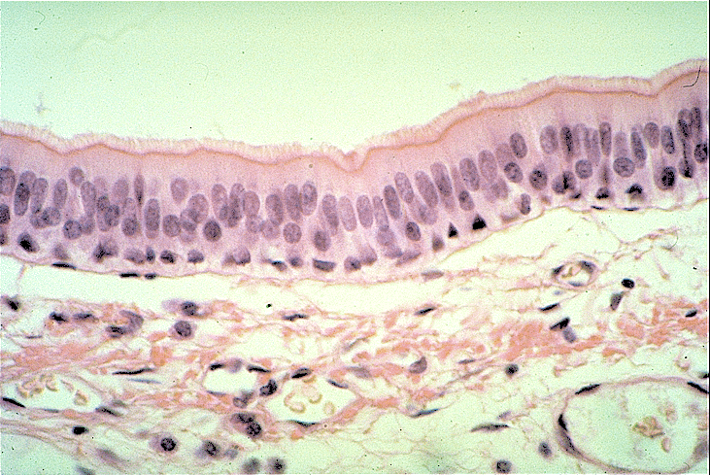
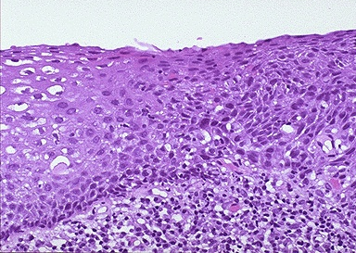
Activity:
Lung
Skin
Breast Duct
Lumen
Lumen
Lumen
Epithelial/Parenchyma
Epithelial/Parenchyma
Epithelial/Parenchyma
Stroma
Stroma
Stroma
Basement membrane
Cervix
Prostate
Lumen
Epithelial/Parenchyma
Lumen
Epithelial/
Parenchyma
Stroma
Stroma

Slide 28
Wrap Up
Epithelial cells are the most exposed to the outside world and carcinogens.
Lumen
Epithelial
cells
Parenchyma
Basement membrane
Stroma
Esophagus
Notes:
Discussion has information about what tissue sections are

Slide 29
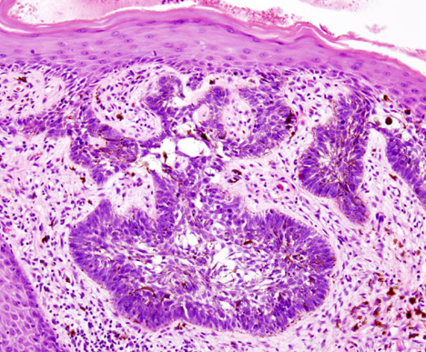
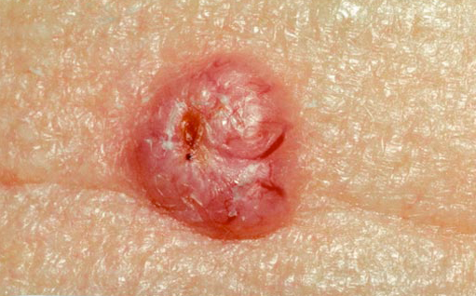
Wrap Up
Tissue information is important!
What cells are cancerous?
Is the basement membrane intact?
Basal Cell carcinoma
Basement membrane intact

Slide 30
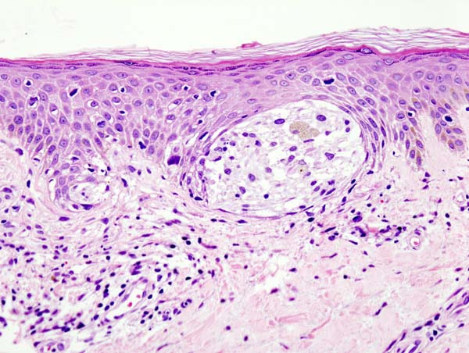
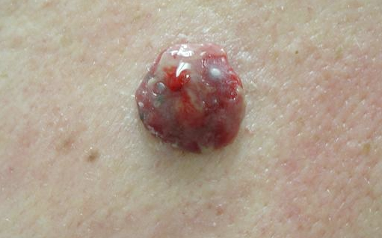
Wrap Up
Tissue information is important!
What cells are cancerous?
Is the basement membrane intact?
Melanoma (carcinoma)
Breach of basement membrane

Slide 31
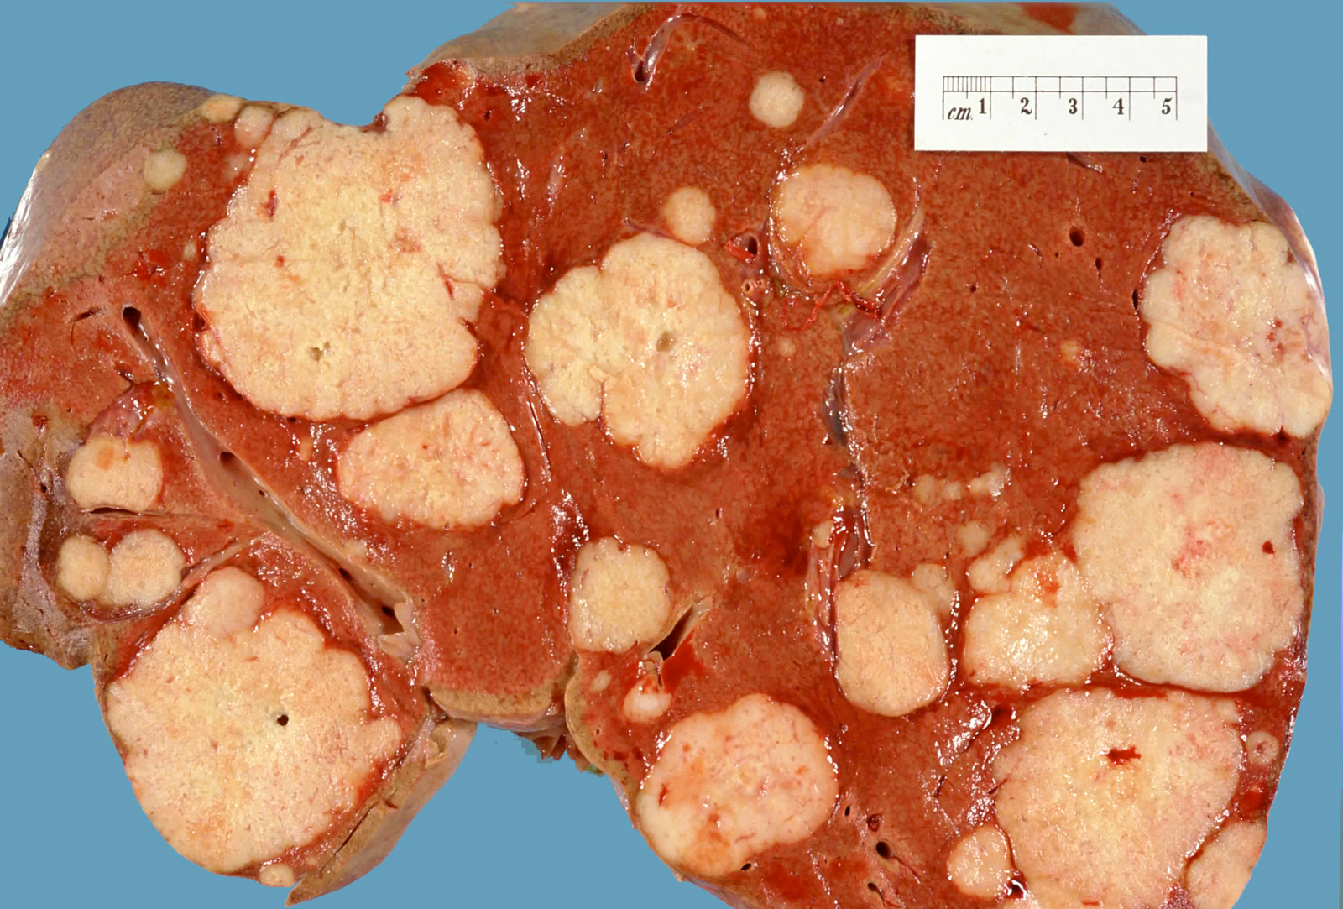
Wrap Up
Is it enough to be able to detect that an organ has a tumor in it?
What else would you want to know about the tumor and its cells?

Slide 32
Homework

